Slide 1
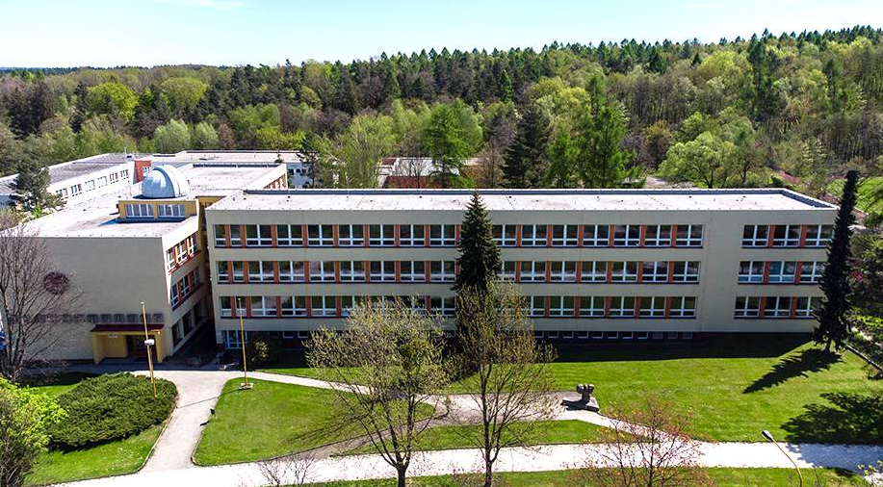
School with a rich tradition
and modern teaching facilities
webové stránky školy
Prestigious 4 or 8 year Grammar School educational programme
Technologically well- equipped School
Special classrooms for science, physics, chemistry, biology, maths, languages, gymnasium, music room, atelier, community kitchen, football pitch and a track.
Renovated building with sports field, situated on the outskirts of an industrial city, close to a wooded park
Modern facilities for students: school library, buffet with a wide variety of food options, renovated locker rooms, and an up-to-date school courtyard
Ředitelka školy: PhDr. Hana Čížová, cizova@gsh.cz
prezentační video o škole

Slide 2
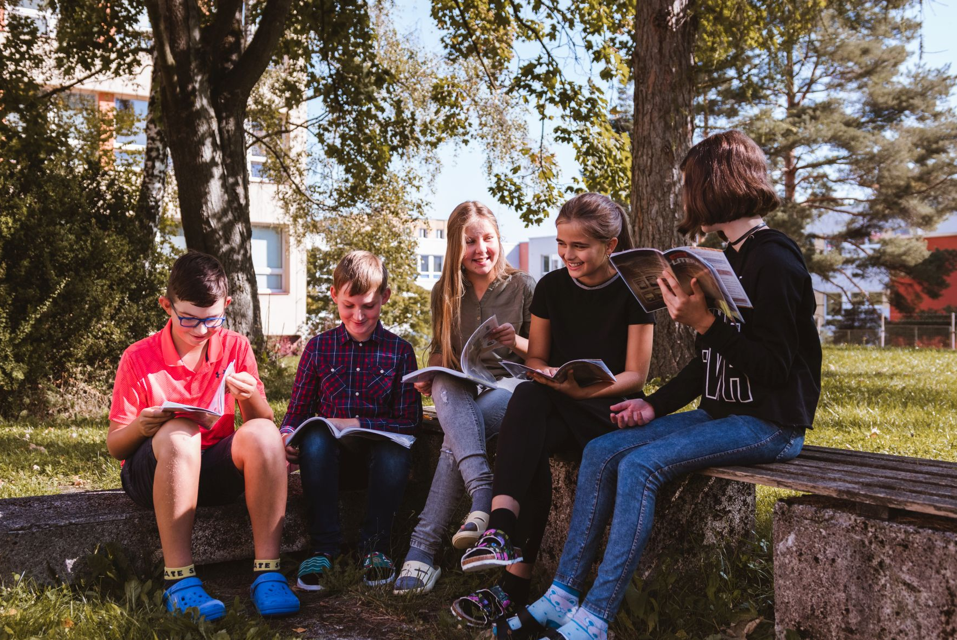
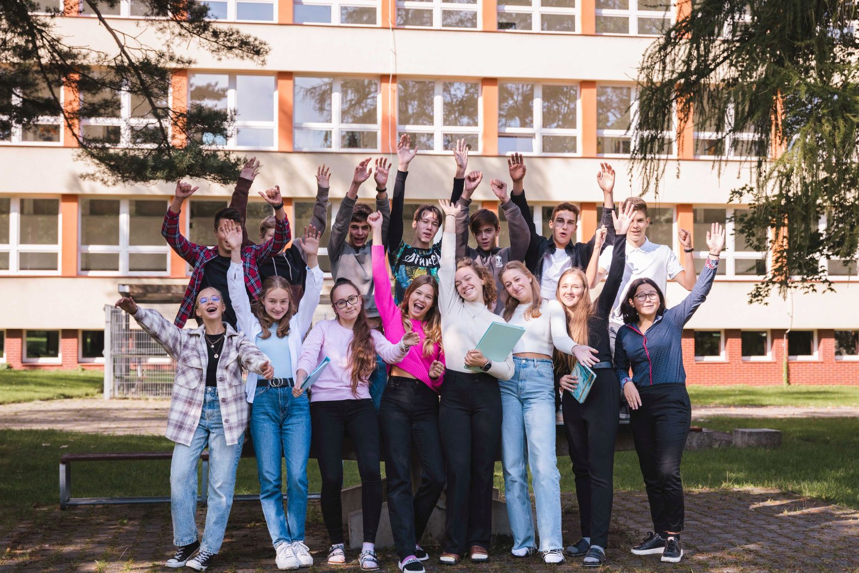
School educational programme from Haviřov to Europe
School offers 5 world languages
Preparation for international language tests (FCE, DSD)
Achievments of our students:
Excellent results of our students in science and language competitions
Bridge - long-term numerous achievements of our players
Debate club
School offers students specialization
Graduating students can choose 6 seminars
A wide range of linguistics, civics, science and specialized subjects (programming, economy, law, psychology)
Great emphasis is placed on building a friendly school climate, and the well-being of our students
School Parliament – develops the entrepreneurship and creativity of pupils through the implementation of real activites
Attractive domestic and foreign sports courses, excursions and sightseeing tours

Slide 3
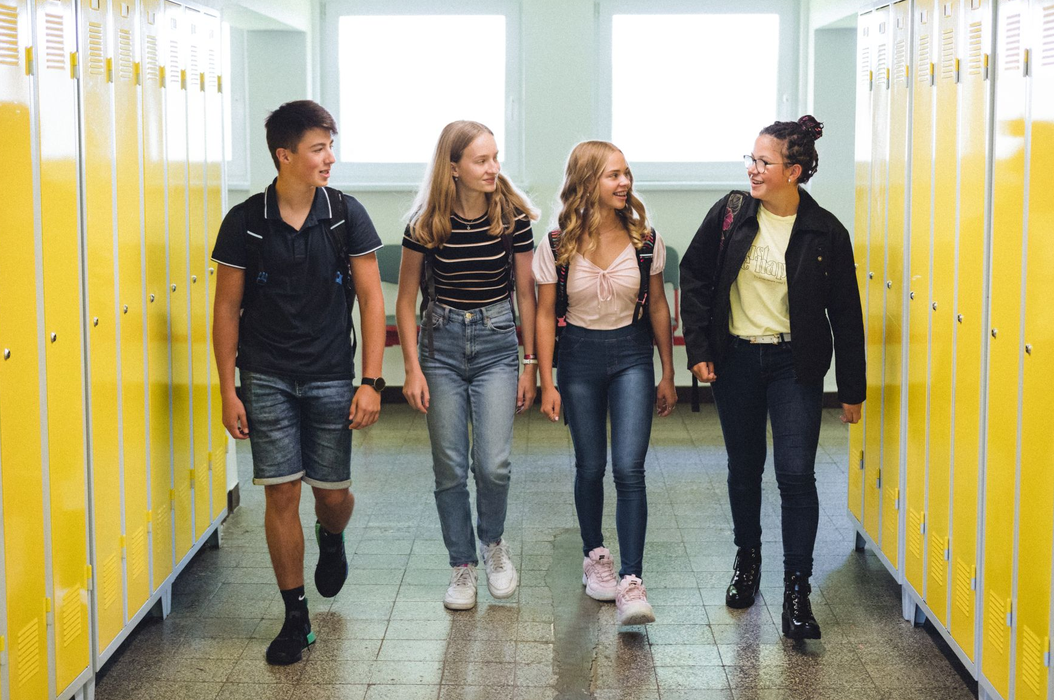
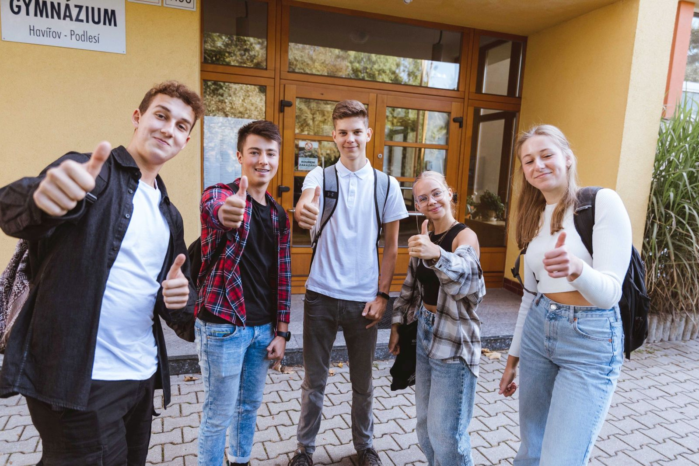
ERASMUS+ From Havířov to Europe
Challenge
To develop the learning potential of all people involved in the educational process
Goal
Cleaner and greener region – environmental education, studying and awareness of polytechnic education, including mitigating the impact of the end of coal mining on the labour market
Main group
students 15-18
Main countries of destination
German-speaking countries, Spain, Slovenia

